Slide 1
If It Isn't Codified, It Doesn't Exist: Leveraging Configuration Management
Albert Holtsclaw

Slide 2
Notes:
I want to walk through some housekeeping to ensure everyone gets the most out of today’s learning session.
All participants are automatically muted to cut down on background noise
Please type any questions using the Q&A feature of the webinar toolbar
Live transcript is enabled and located in the webinar toolbar if you would like to turn on closed captioning.
The presentation will be recorded and will be available to attendees for 30 days on the SIGConnect website

Slide 3
Albert Holtsclaw
Senior Consultant
holtsclaw@sigcorp.com
DBA / DevOps wrangler of Ellucian's Banner ERP system and ancillary products and services for clients on-premise and in the cloud.

Slide 4
Configuration Management Overview
What is Configuration Management?
What are the benefits ?
What tools are available?
Introduction to Puppet
Introduction to Ansible
If It Isn't Codified, It Doesn't Exist

Slide 5
What is Configuration Management
Configuration management is a process for maintaining computer systems, servers, and software in a desired, consistent state. It’s a way to make sure that a system performs as it’s expected to as changes are made over time.
Ideally
Define system state in a declarative language
Tracked in source control
Managed by tools for applying and enforcing changes
Supports automation
https://www.redhat.com/en/topics/automation/what-is-configuration-management

Slide 6
Configuration Management Benefits
Avoids configuration drift / undocumented changes
Self documenting
Mitigates issues with configuration differences
Application Health (performance differences, inconsistent behaviors, etc.)
Security
Regulatory Compliance
Improves ability to make changes quickly
Centralized configurations and classifications (modify once in definition)
Reusable definitions (build common configurations)
Repeatable
Disaster Recovery (rebuild fast)
Scalability (apply reusable definitions to multiple hosts)
Auditable (change management & tracking, who-what-when)

Slide 7
Configuration Management Tools
Should:
Allow the definition of a declarative “state” of a managed system
Allow the classification and management of systems by groups/subgroups/roles (to associate desired state information)
Support or integrate with automation and/or continuous integration/continuous deployment
Allow traceability/auditing of changes of configuration, either natively or through integration with source control systems
In doing so, allow definitions to: Be readable, Be auditable, Be repeatable

Slide 8
Configuration Management Tools
Pseudo Example:
Define role/group of “Apache Tomcat Server”
Store definition(s) in source control
Associate 20 new virtual machines to role/group
Apply change: tool installs and configures Apache Tomcat and associated configuration files as defined
Outcomes:
No need to manually login to any of the 20 hosts to apply changes.
Can add additional hosts later by associating new hosts with existing role/group.
Machines are configured to exact desired state
Improves maintainability (repeatable) and business continuity (disaster recovery)
Changes can be reviewed over time and are auditable/verifiable

Slide 9
Configuration Management Tools (top 4)
(master, master)
Puppet: Client-Server (Master/Puppets)
Ansible: Headless (Master Only)
Chef: Client-Server (Master/Agents)
Salt Stack: Client-Server (Master/Minions)
Detailed tools comparison:
https://medium.com/successivetech/chef-vs-puppet-vs-ansible-vs-saltstack-a-complete-comparison-9af8f1790c0d
Compare Two Most Popular: Puppet vs Ansible

Slide 10
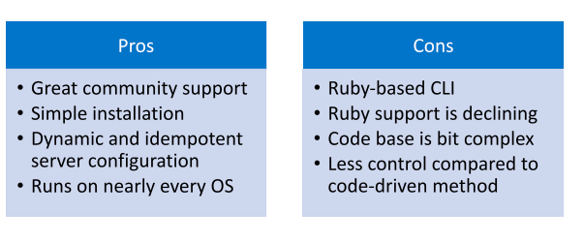
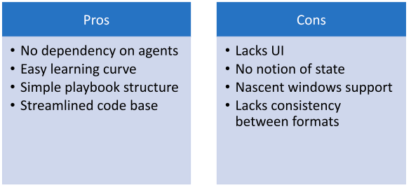
Puppet vs Ansible
Ansible
Puppet
Detailed tools comparison:
https://medium.com/successivetech/chef-vs-puppet-vs-ansible-vs-saltstack-a-complete-comparison-9af8f1790c0d

Slide 11
Puppet

Slide 12
Puppet
Monolithic, former gold standard
Agent-based
Apply/Enforces config
Host 1
Puppet Master
Git / Source Control
Host 2
optional
Host 3
Host ...

Slide 13
Puppet
Master/Puppets connected to source control for definitions
Hiera
Hierarchy Node-specific or fact-based config (OS version, etc.)
:PROD branch
Git / Source Control
Host 1
Puppetfile
Roles, Profiles, Modules
Puppet Master
Code Deploy
Host 2
:DEV branch
Puppetfile
Roles, Profiles, Modules
Host 3
Hiera
Hierarchy Node-specific or fact-based config
Host ...

Slide 14
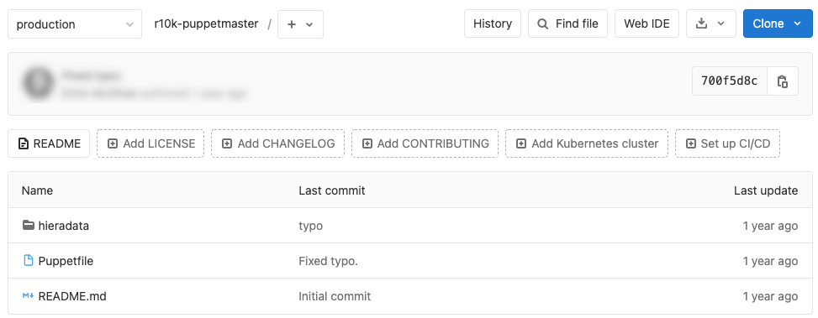
Puppet
Git “branch based” environments

Slide 15
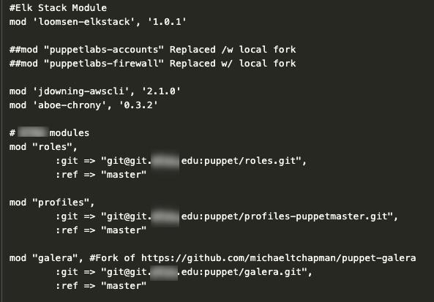
Puppet
Puppetfile - Modules

Slide 16
Puppet Definitions
Roles
Profiles
Modules
Resource Types (file, exec)
Profile::
IPTables Rules
Resource:: File /etc/sysconfig/iptables
Oracle DB Host 1
Role::
OracleDB
Resource:: File /etc/passwd /etc/shadow /etc/groups
SSH Keys
Profile::
Users and Groups
Accounts Module
Profile::
Oracle Software
Oracle DB Module
Resource:: File /etc/oratab /u01/apps/oracle/*

Slide 17
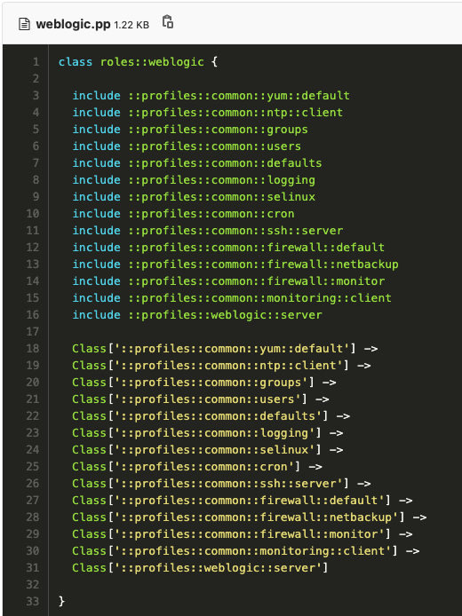
Puppet Role (WebLogic)
Imports and uses multiple profiles

Slide 18
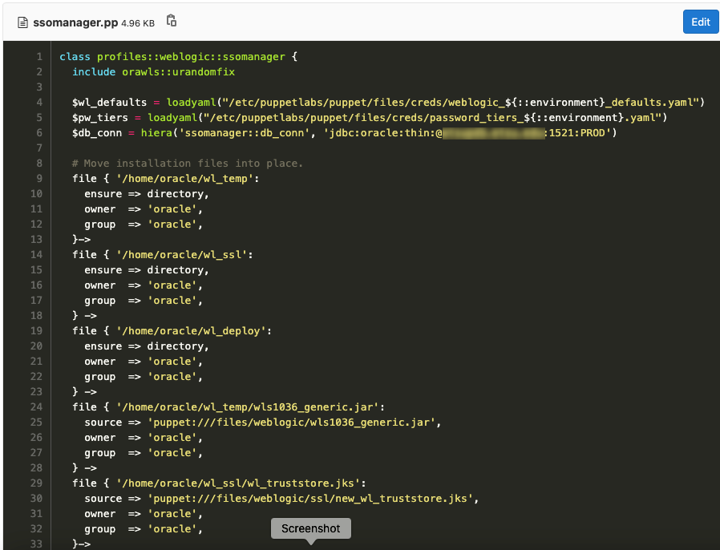
Puppet Profile (WebLogic)

Slide 19
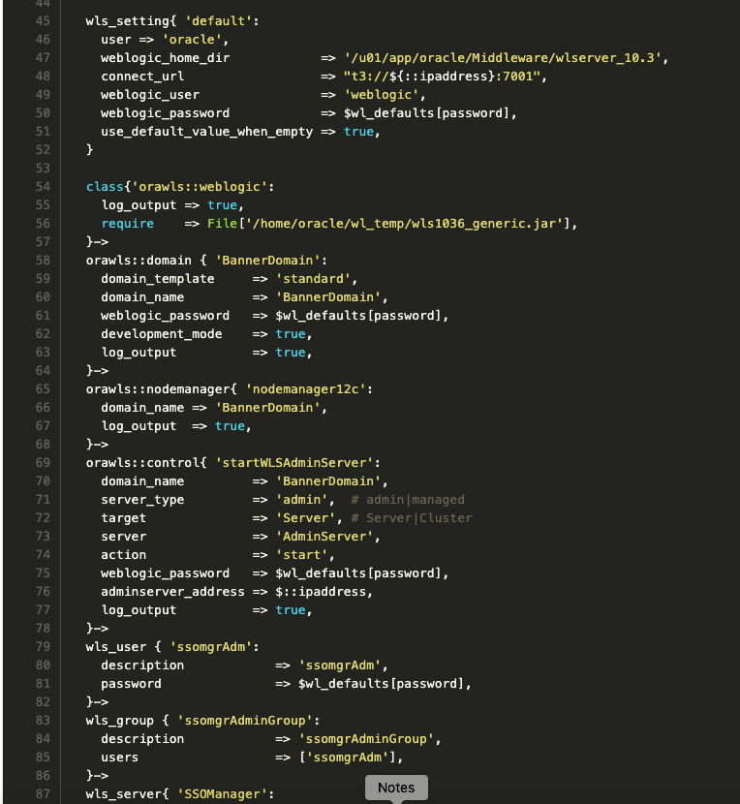
Puppet Module (WebLogic / orawls)

Slide 20
Puppet Hiera: Host or fact-based configs

Slide 21
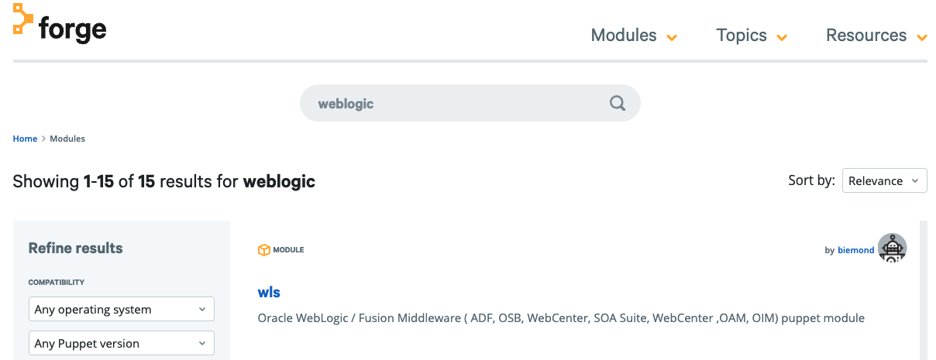
Puppet Forge / Community
https://forge.puppet.com/

Slide 22
Puppet Register Node
Install Agent
Accept Certificate
curl -k https://puppetmaster.albybum.net:8140/packages/current/install.bash | sudo bash

Slide 23
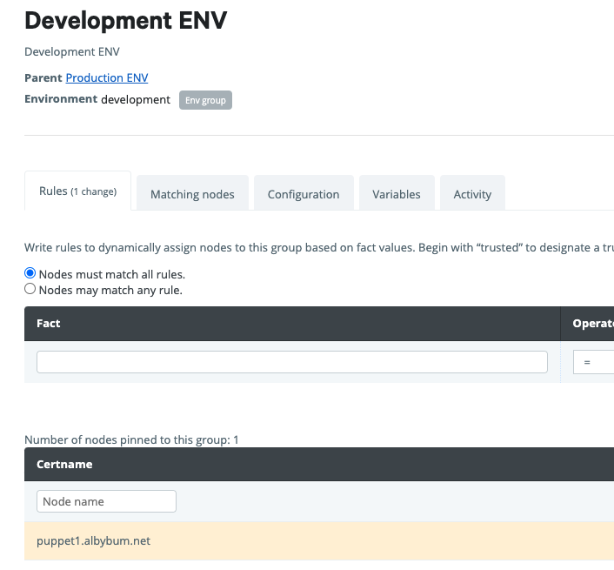
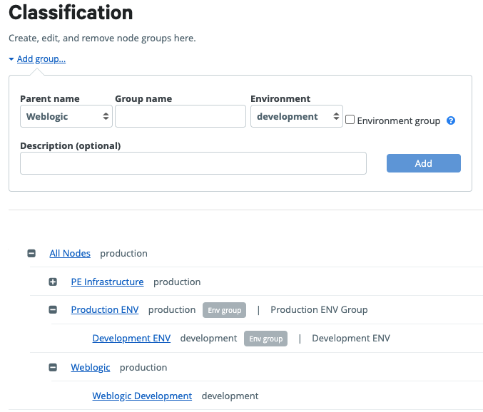
Puppet Register Node
Assign Classification(s)
By ENV
Function/Role

Slide 24
Puppet Apply Changes

Slide 25
Ansible

Slide 26
Ansible
Lightweight and current king of market share for CM tools
Push-based config
Host 1
Ansible Client Host
Git / Source Control
Host 2
optional
Host 3
Host ...

Slide 27
Ansible
Inventory / Host list
Playbooks (or ad-hoc commands)
Roles

Slide 28
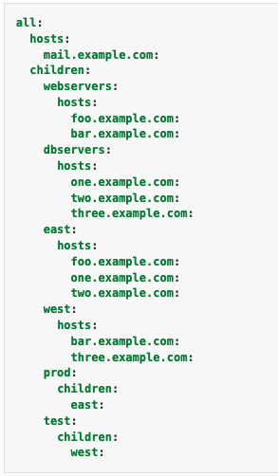
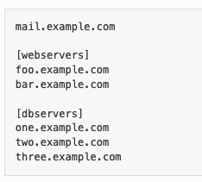
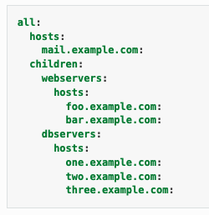
Ansible Inventory
Host list
Various formats and complexity

Slide 29
Ansible Inventory
Host parameters (ssh keys, etc.)

Slide 30
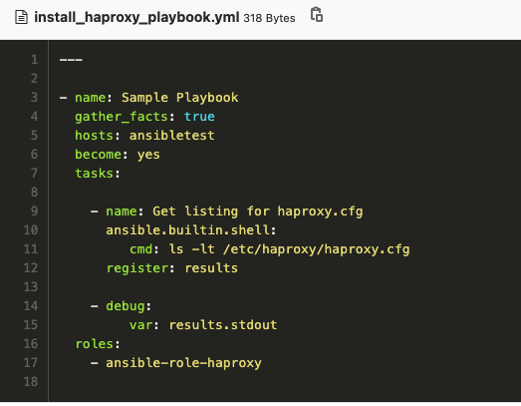
Ansible Playbook
Install HAProxy

Slide 31
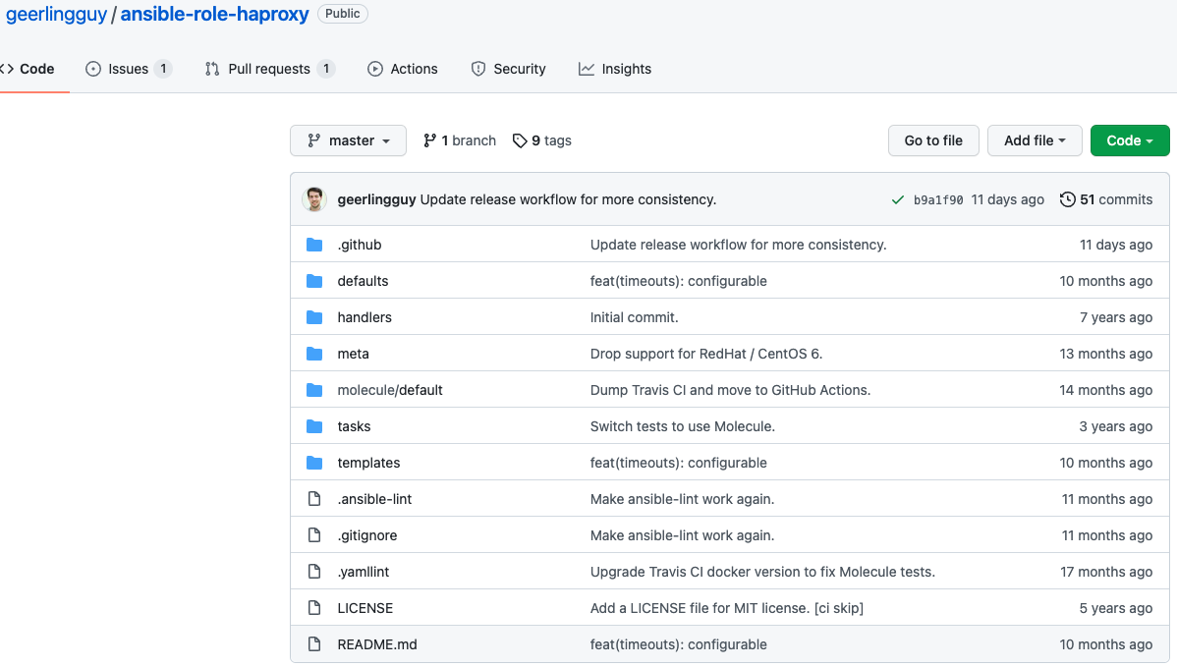
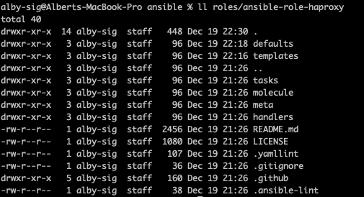
Ansible Role

Slide 32
Ansible Role Template

Slide 33
Ansible Role Defaults

Slide 34
Ansible Execute Playbook
ansible-playbook -i allhosts -u centos install_haproxy_playbook.yml --limit ansibletest
Inventory File: allhosts

Slide 35
Ansible Execute Playbook

Slide 36
Ansible Execute Playbook

Slide 37
Ansible Ad-hoc commands
ansible ansibletest -i allhosts -u centos -m ansible.builtin.shell -a 'ls -lt /'
Inventory File: allhosts

Slide 38
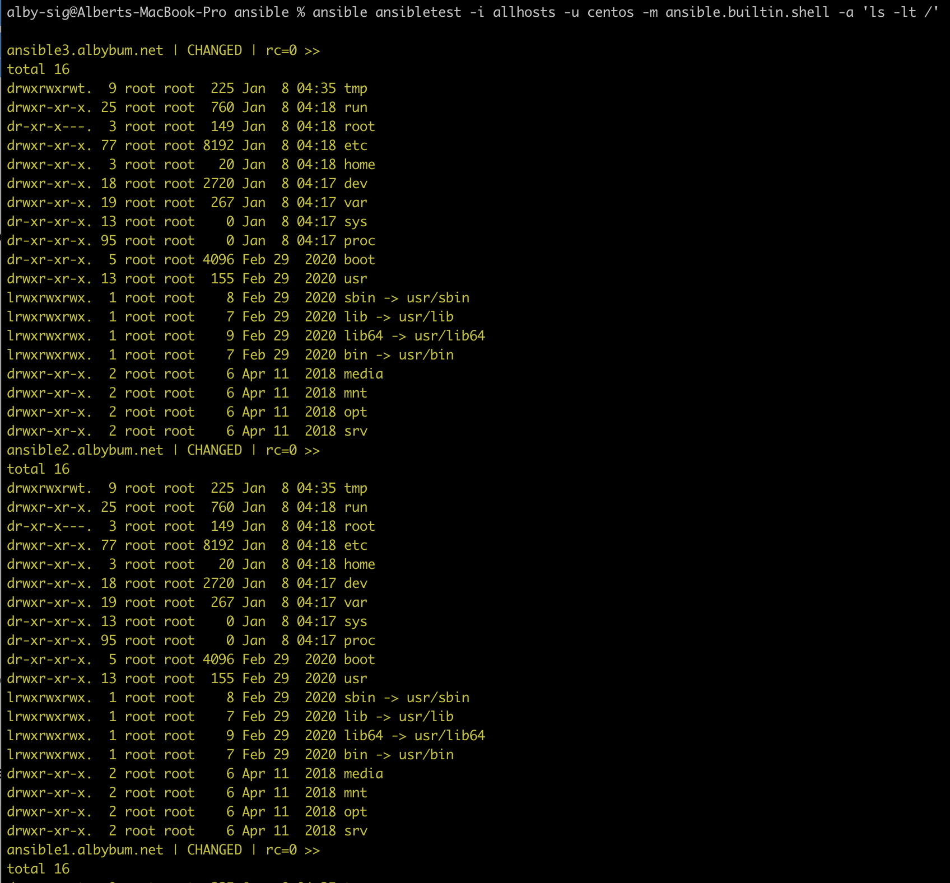
Ansible Ad-hoc commands
Log4j-core discovery, etc.
Not CM specific but useful

Slide 39
If It Isn't Codified, It Doesn't Exist

Slide 40
Benefits Revisited
Avoids configuration drift / undocumented changes
Improves maintainability / make changes quickly
Repeatable
Auditable
Without Configuration Management:
Do you have well defined requirements for servers?
“build the new one exactly like old one” or “ask Bob, he should know”
Can you recover or rebuild quickly (or at all) if your backups fail?
Do you have consistent configurations in your environment?
Can you quickly make config. changes or quickly add new fully-configured hosts?
Do you have traceability for changes in configuration?
Much like documentation, if it isn’t codified, it may as well not exist. It may be living inside someone’s head.

Slide 41
Costs
Ansible: Completely Free and Open Source
Puppet: Open Source… but
Open Source Puppet / Community Edition
Free, but missing some key features (central console, code management, etc.)
Puppet Enterprise
Per Node License
https://www.upguard.com/blog/open-source-puppet-vs-puppet-enterprise-which-is-right-for-you

Slide 43
Albert Holtsclaw
Senior Consultant
holtsclaw@sigcorp.com

